Slide 1
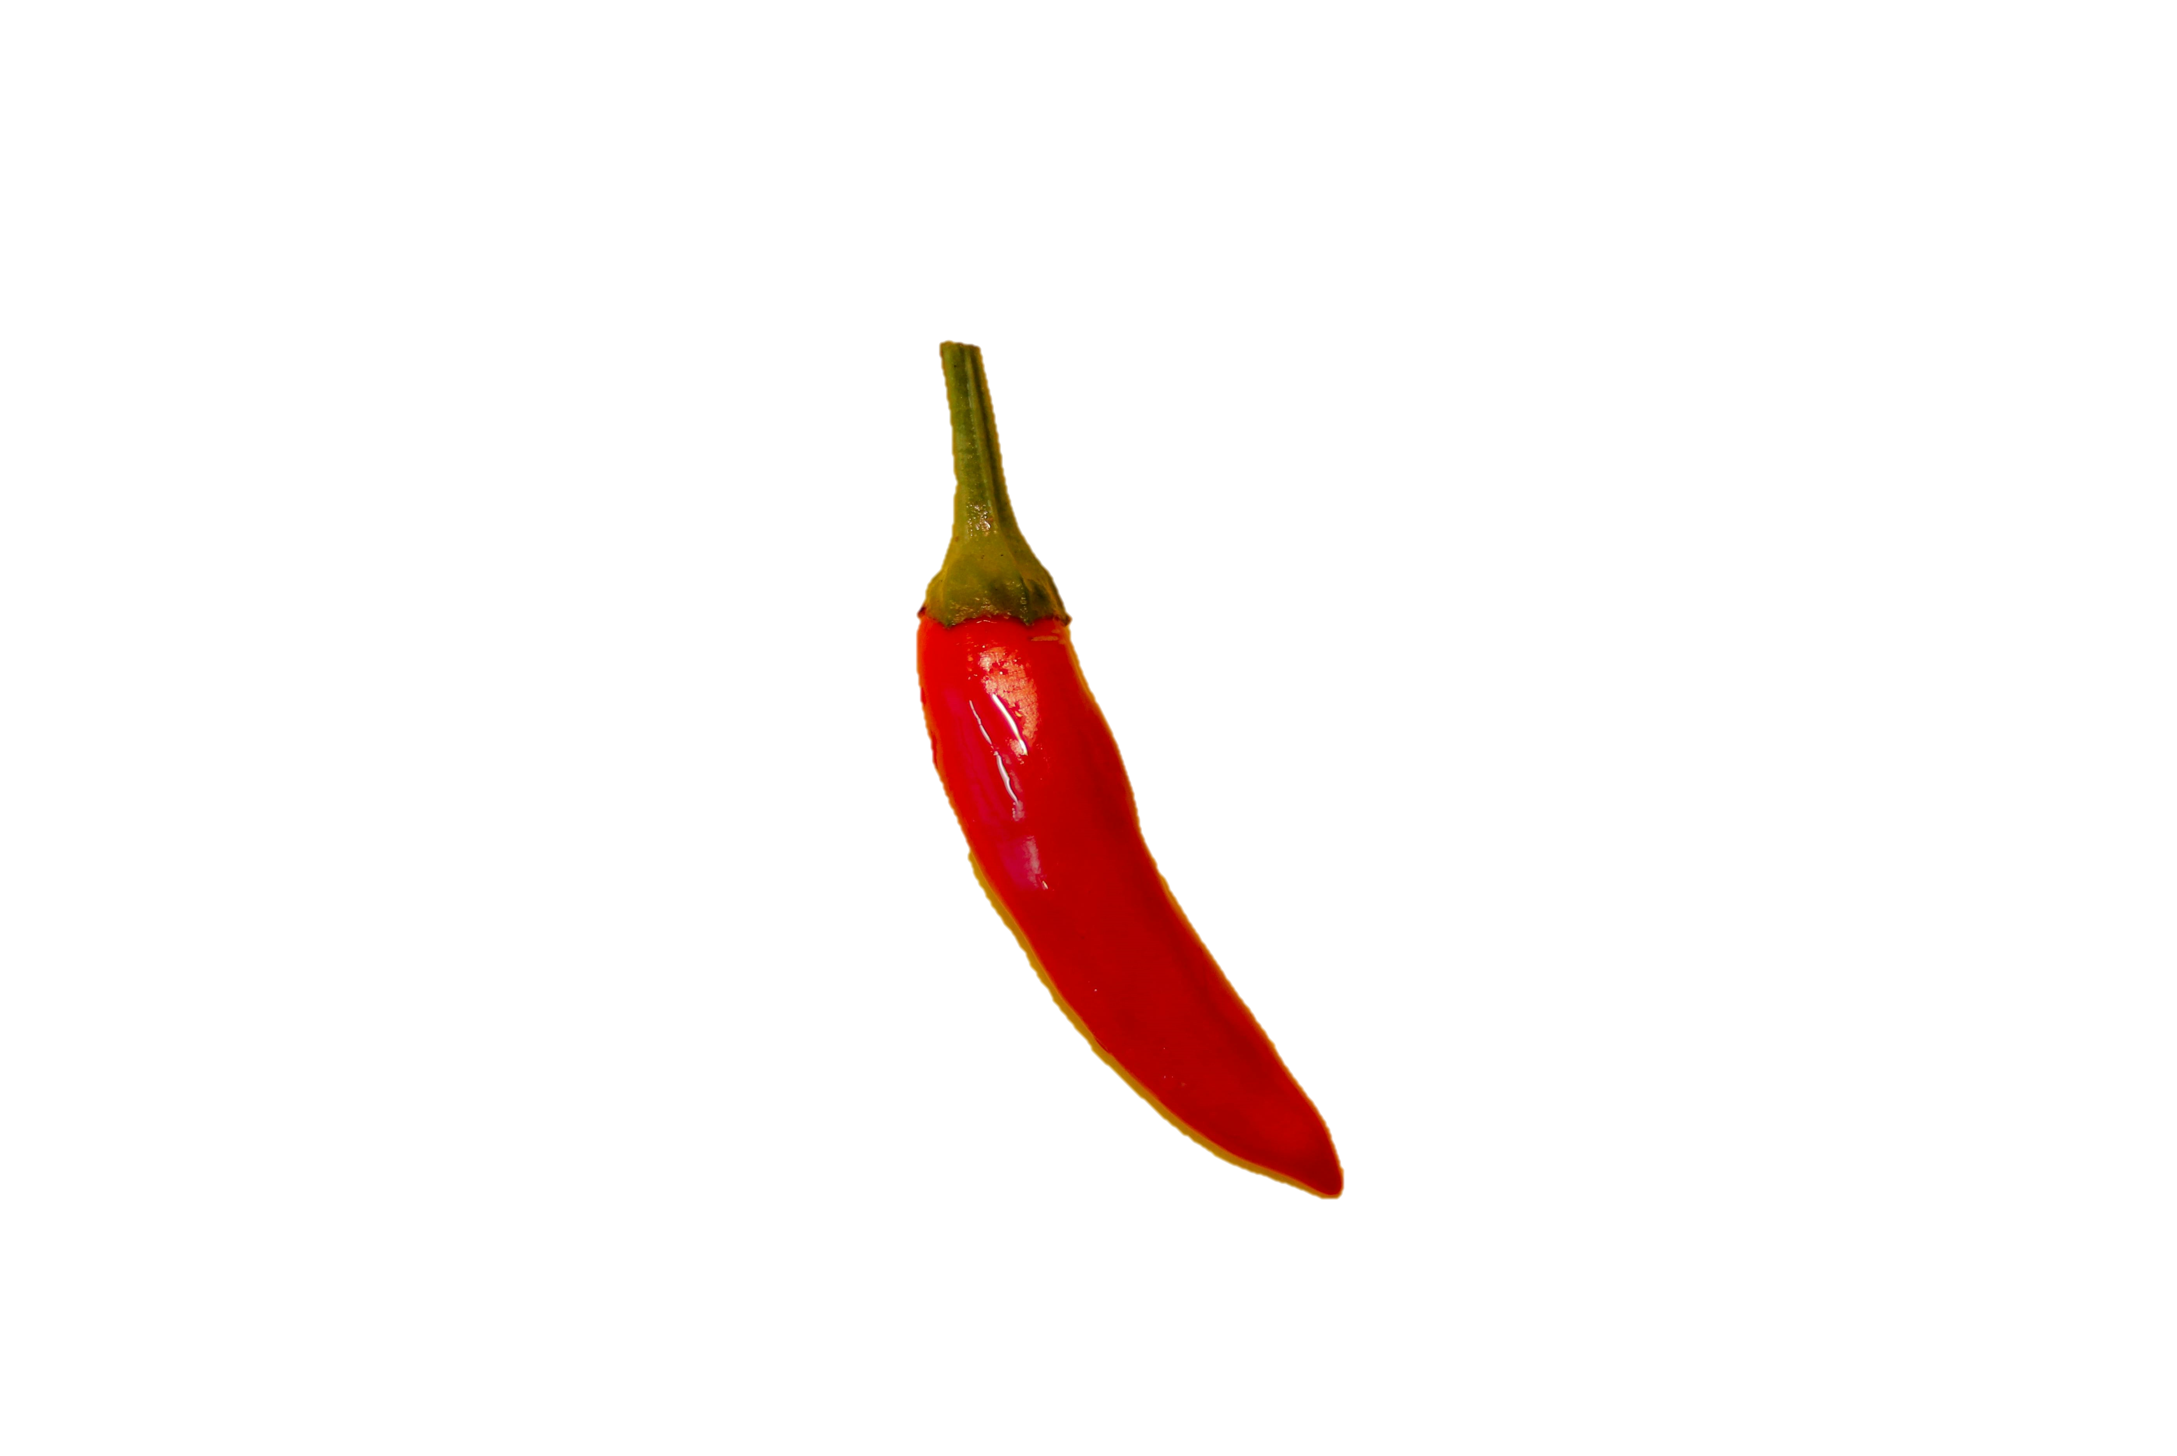
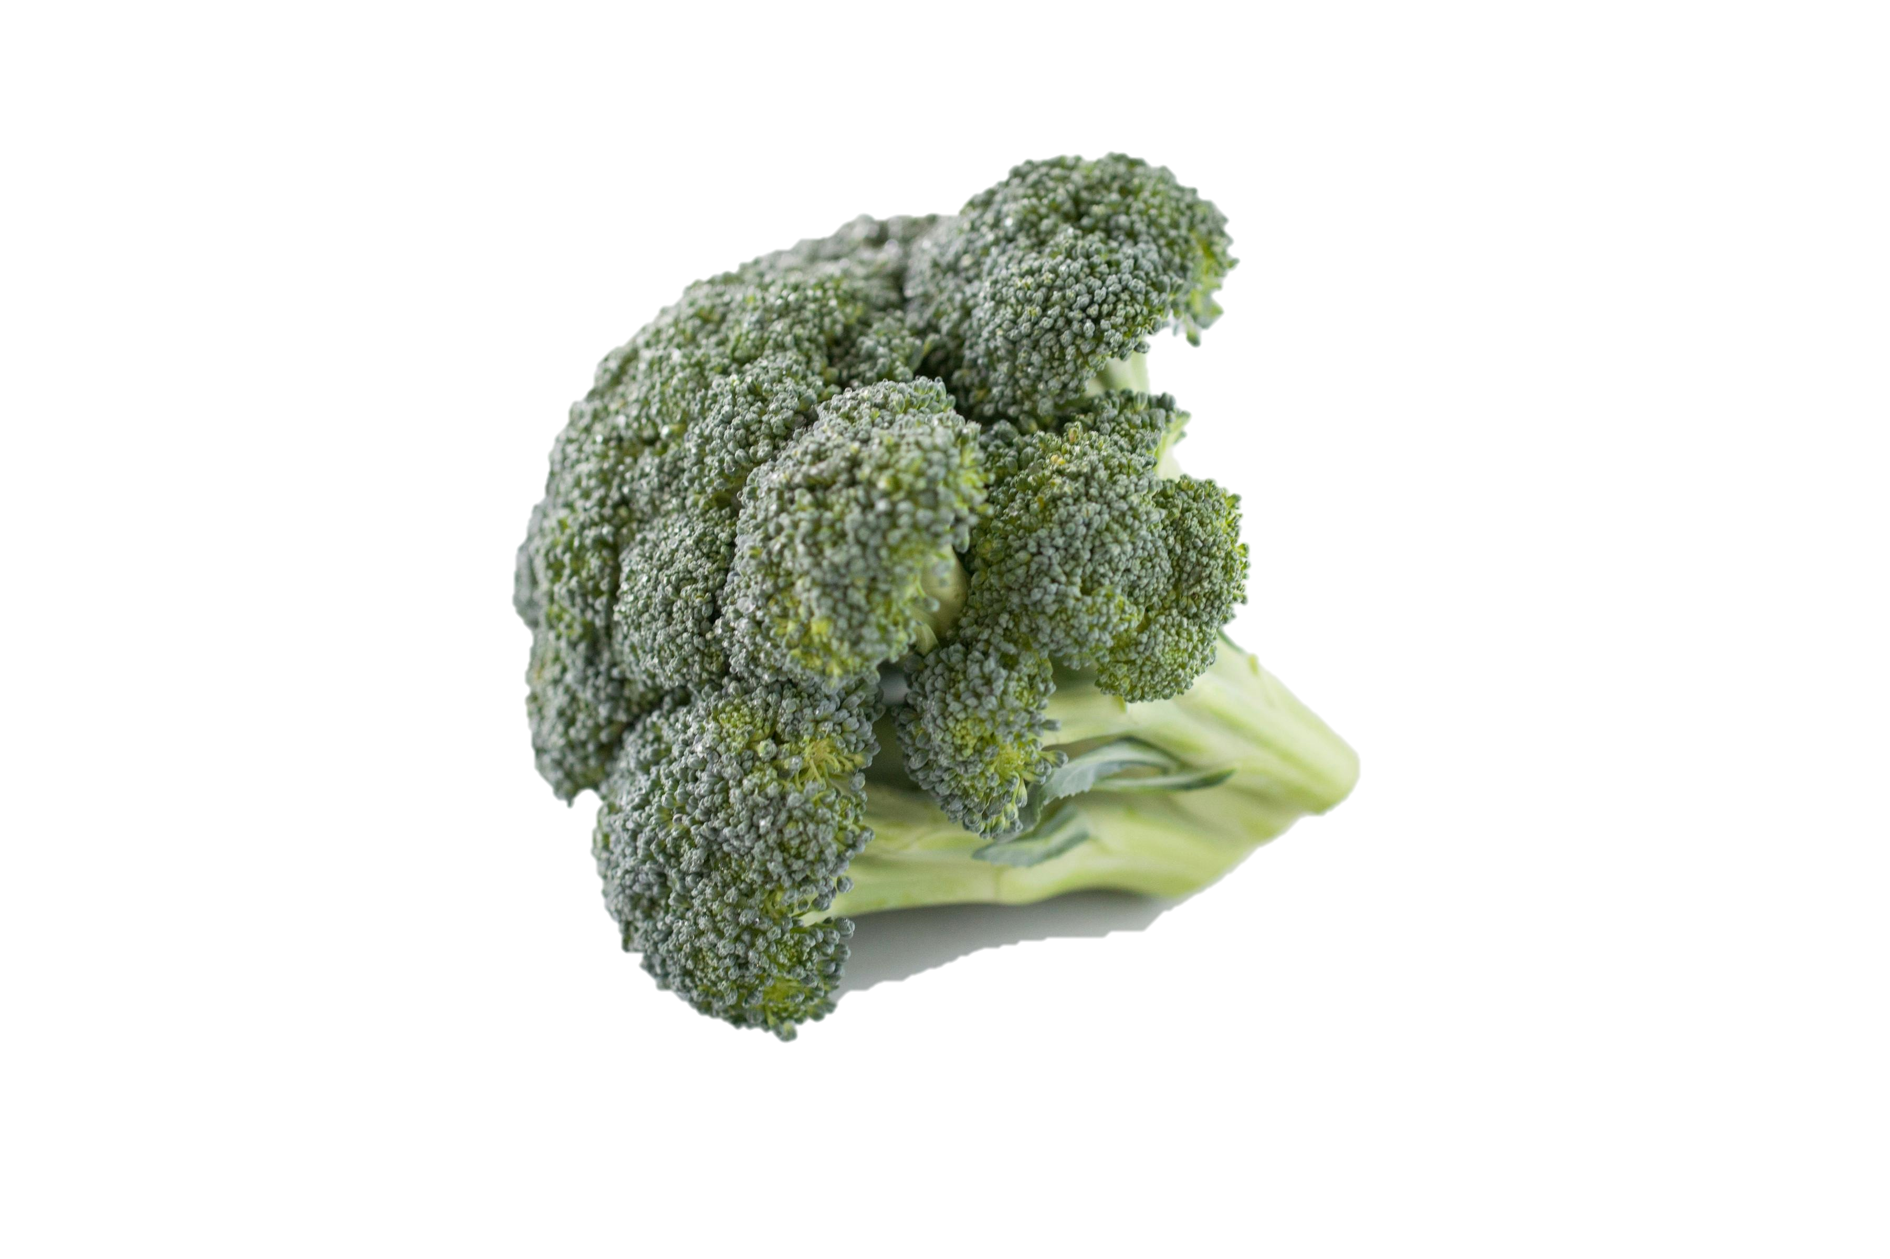
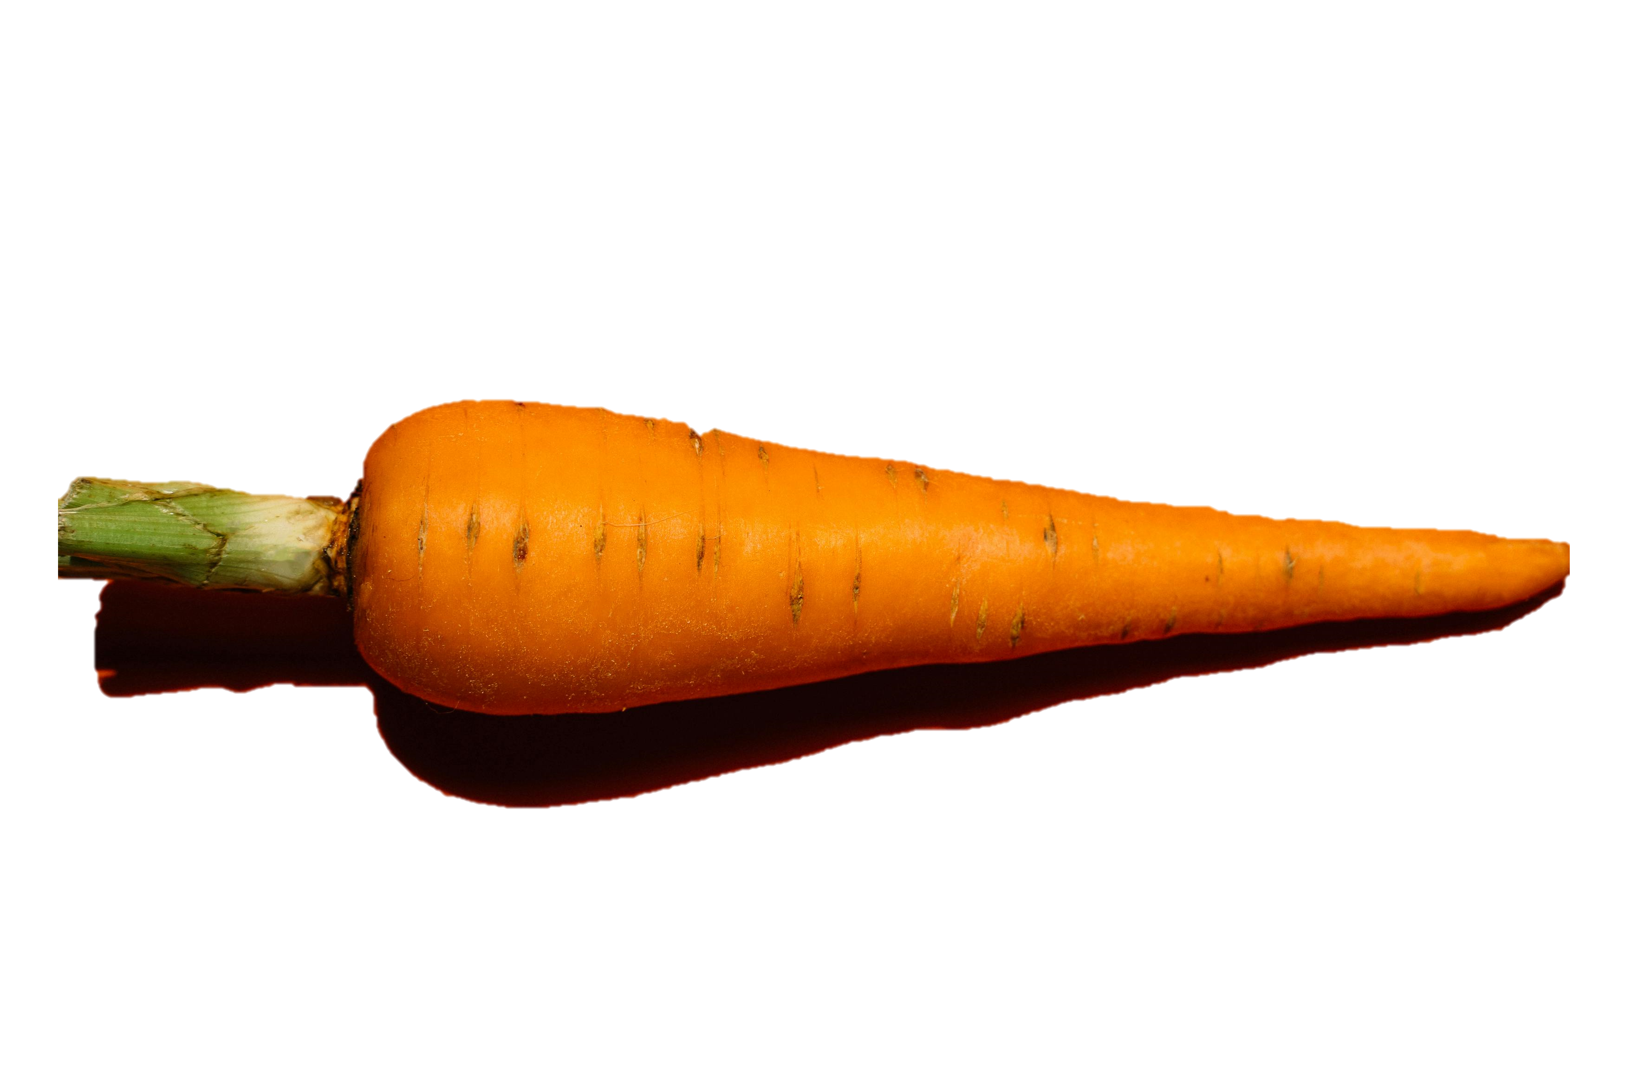
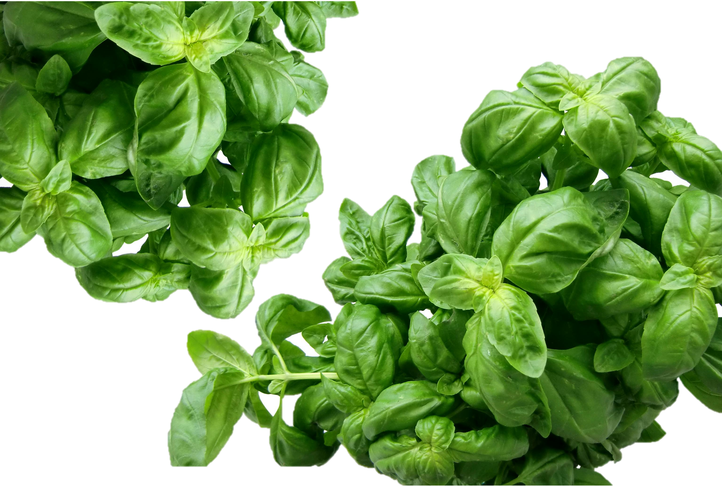
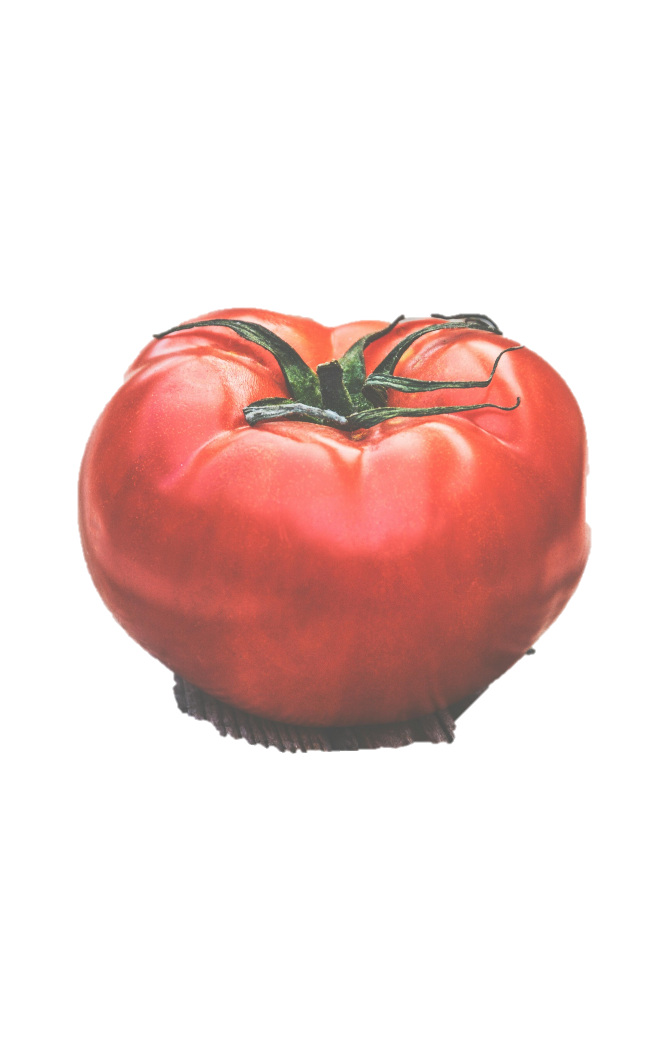


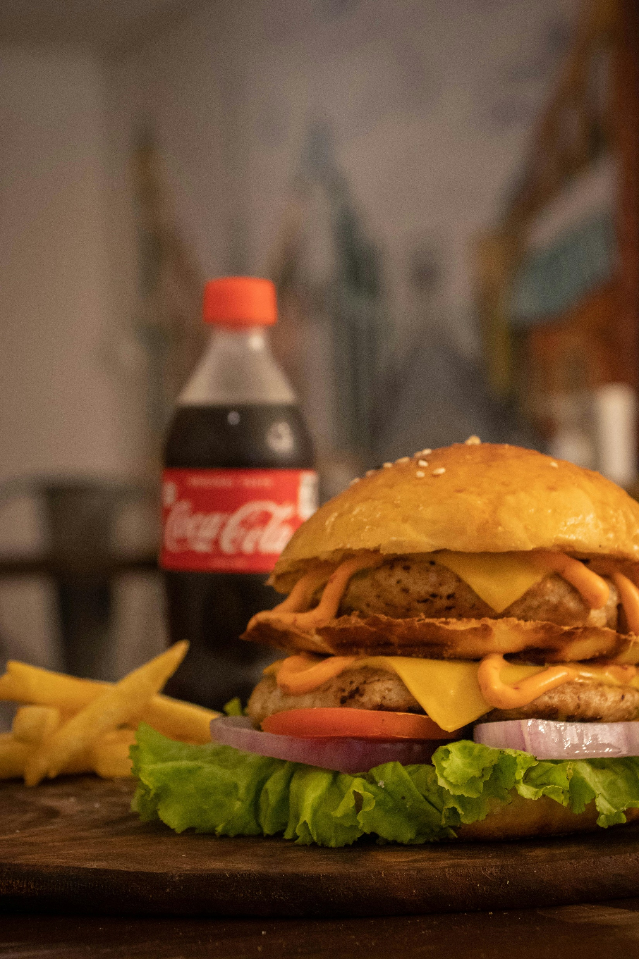
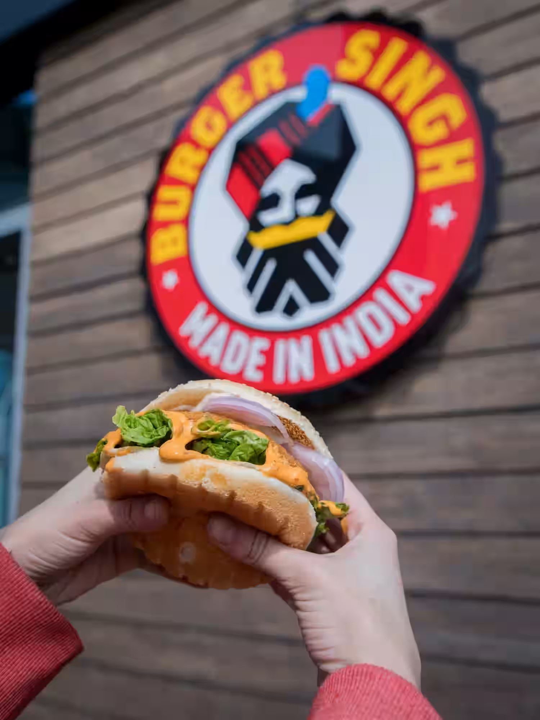

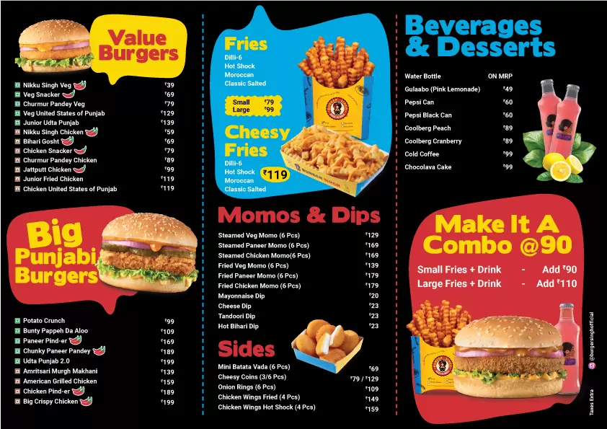

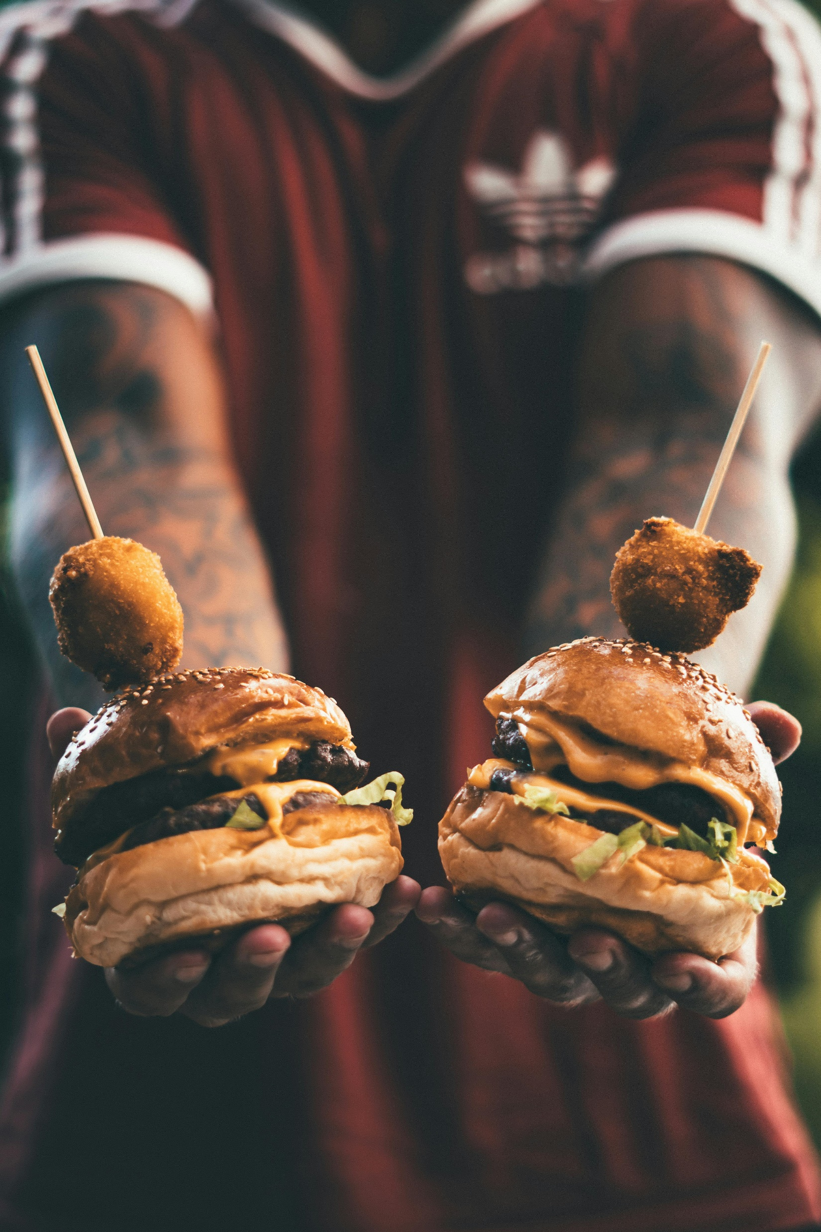
BURGER SINGH

Slide 2
Namaste! Welcome to Burger Singh, where flavor meets delight!
We’re thrilled to have you here. Whether you’re craving a juicy burger, crispy fries, or a refreshing drink, our kitchen is sizzling with goodness.

Slide 3

Namaste! Welcome to Burger Singh, where flavor meets delight!
We’re thrilled to have you here. Whether you’re craving a juicy burger, crispy fries, or a refreshing drink, our kitchen is sizzling with goodness.

Slide 4
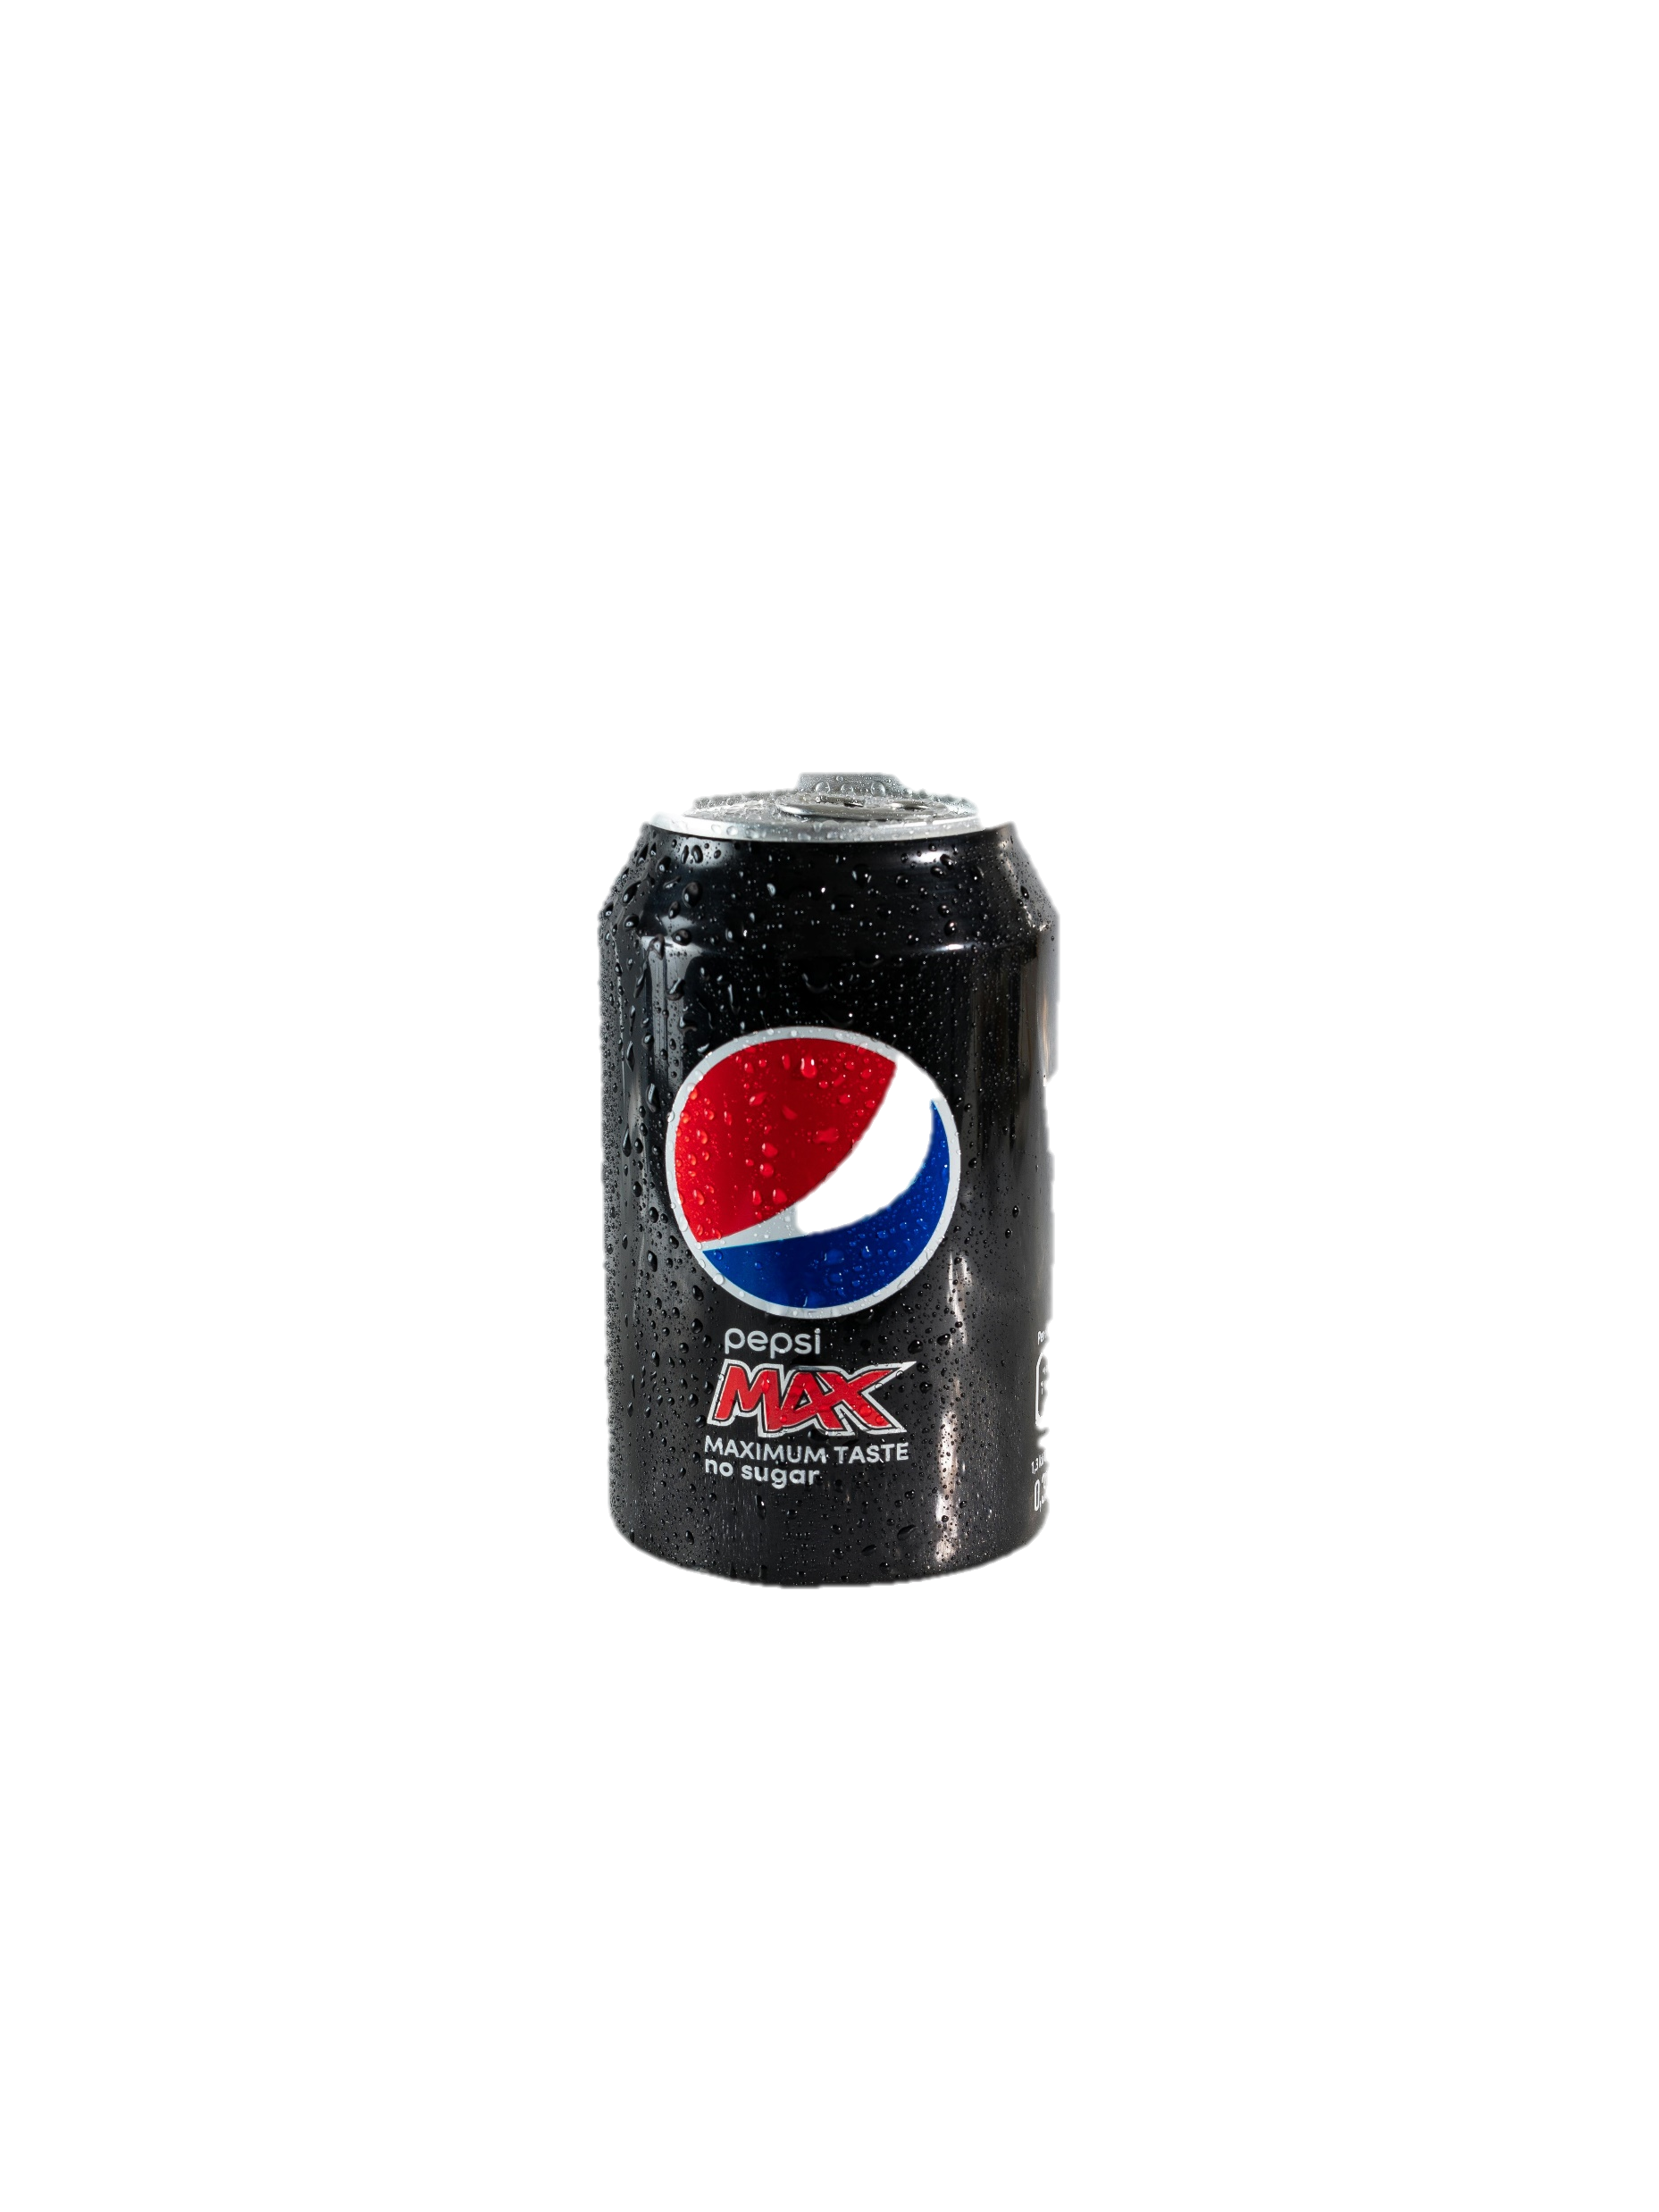
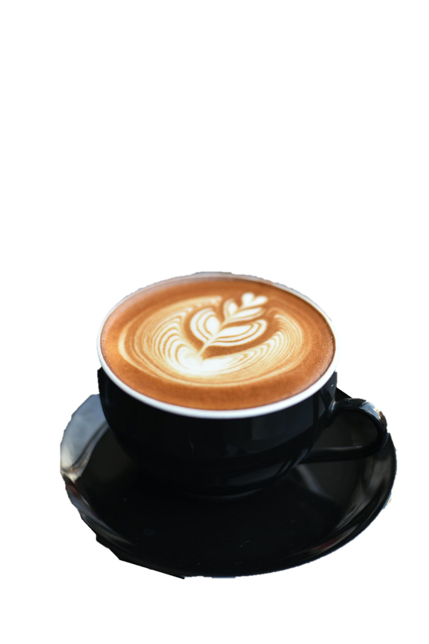
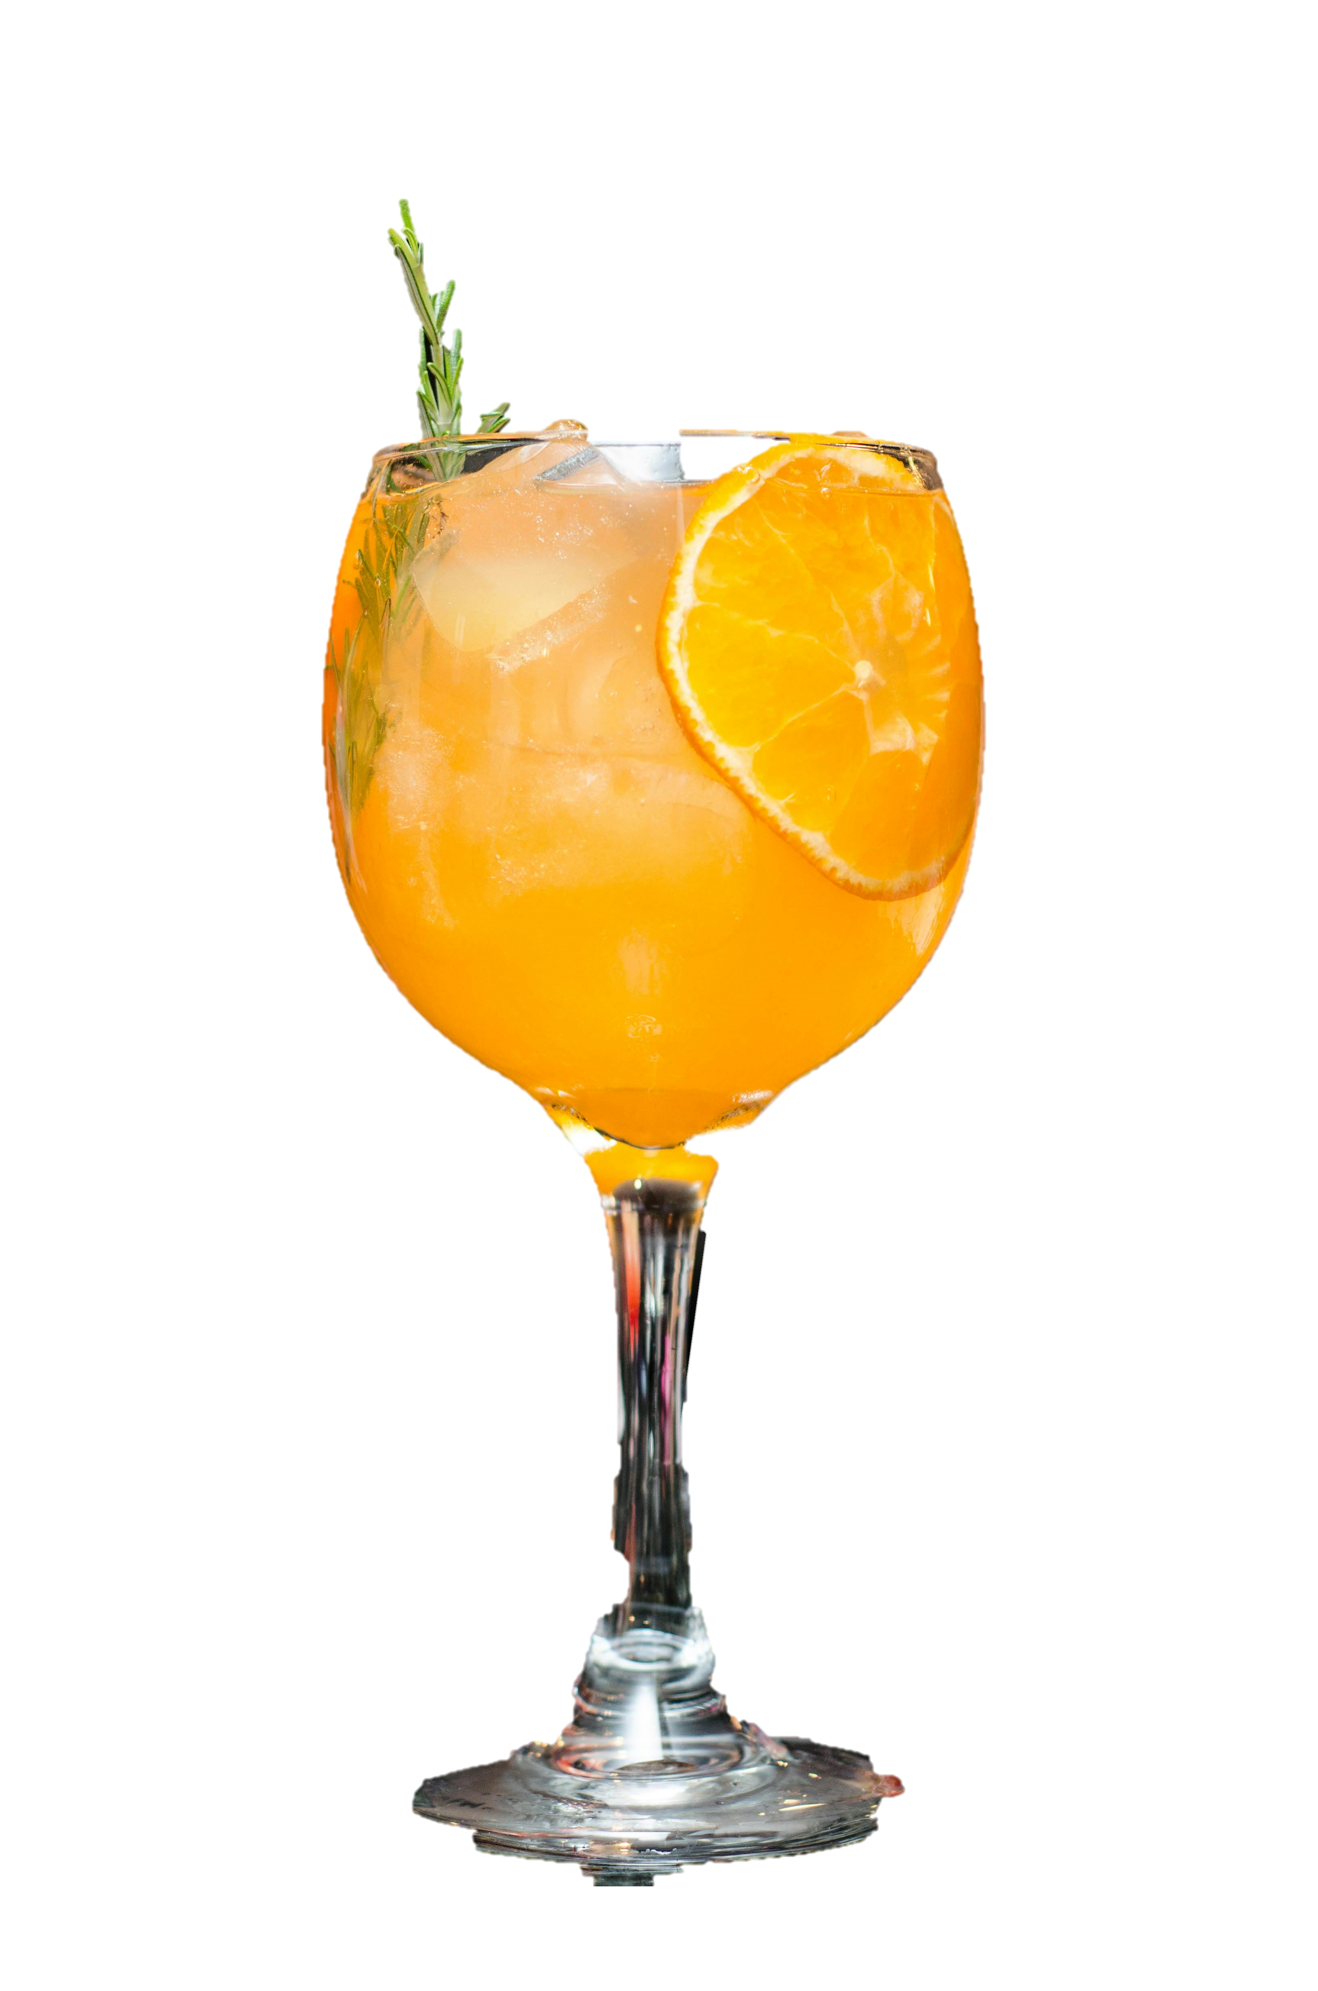
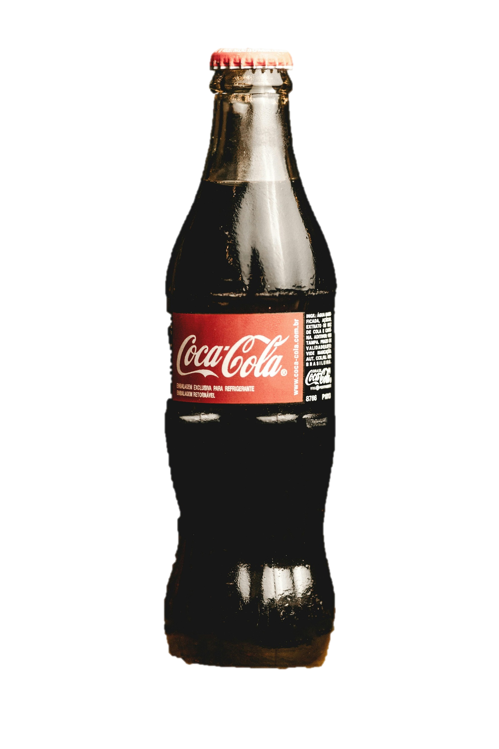
Namaste! Welcome to Burger Singh, where flavor meets delight!
We’re thrilled to have you here. Whether you’re craving a juicy burger, crispy fries, or a refreshing drink, our kitchen is sizzling with goodness.

Slide 5





Namaste! Welcome to Burger Singh, where flavor meets delight!
We’re thrilled to have you here. Whether you’re craving a juicy burger, crispy fries, or a refreshing drink, our kitchen is sizzling with goodness.

Slide 6

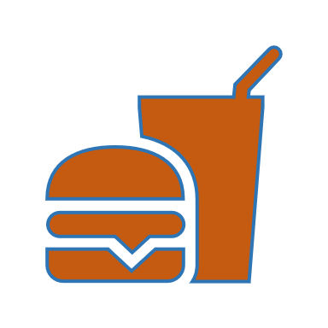



Namaste! Welcome to Burger Singh, where flavor meets delight!
We’re thrilled to have you here. Whether you’re craving a juicy burger, crispy fries, or a refreshing drink, our kitchen is sizzling with goodness.
Quality Ingredients and Bold Creations: What sets Burger Singh apart? Their unwavering commitment to sourcing high-quality ingredients and crafting inventive recipes. From the classic “Singh Burger” (featuring béchamel sauce and fries dipped in creamy cheese) to daring innovations like the “Kheema Pav Burger,” each dish is meticulously designed to tantalize taste buds.
Tech-Savvy Operations: Burger Singh isn’t just about delicious food; it’s also about efficiency. The brand developed its own app, allowing customers to order online and track their meals in real-time. No more waiting—just pure burger bliss! 📱🍟.
Global Ambitions: With an annual turnover of Rs 26 crore, Burger Singh isn’t stopping at local fame. Kabir’s vision extends globally, with a successful pilot franchise in London. Yes, those iconic Indian flavors are now making waves across borders!
50 Outlets and Counting: From that single food truck, Burger Singh has expanded to 50 outlets across north and central India. Their fusion burgers continue to delight hungry hearts everywhere.

